Slide 1
U.S. Scientists: data at a glance
Numbers, location, and economic impact
Gigi Jones
4/23/2021
UC Berkeley Extension Data Boot camp
Project 2 – storytelling with data visualizations
Notes:
How many are there?
Where are they?
What’s their workforce contribution to the U.S. economic?

Slide 2


Why look at U.S. scientists?
Work related
The National Center for Science and Engineering Statistics (NCSES)
Nation’s leading provider of statistical data
U.S. science and engineering (S&E) enterprise
Education and employment
R&D
Business and Industry
State, National, and International comparisons
https://www.nsf.gov/statistics/
Notes:
FEDERAL PRINCIPAL STATISTICAL AGENCIES
Well known:
U.S. Census Bureau
Bureau of Labor Statistics
May not of hear of:
Bureau of Justice Statistics
National Center for Education Statistics
Statistics of Income
Economic Research Service

Slide 3
Data Coding approach
Goals:
Reverse engineer/replicate/improve upon current NCSES data visualizations
Expand or connect existing NCSES data
Through the use of Nobel prize laureate data
Find a story from the data

Slide 4
Data munging techniques/tools
Web scraped Nobel Prize Org and Wiki Websites
OpenCage Geocoder – API to look up latitude and longitude coords
Pandas to clean and code for graphs
Postgresql/PGAdmin to set up Nobel Prize database; CSV files for NSCES data
Flask API, Sqlalchemy, Plotly JS, Leaflet, Bootswatch libraries

Slide 5

SCREEN SHOTS of Data visualizations

Slide 6
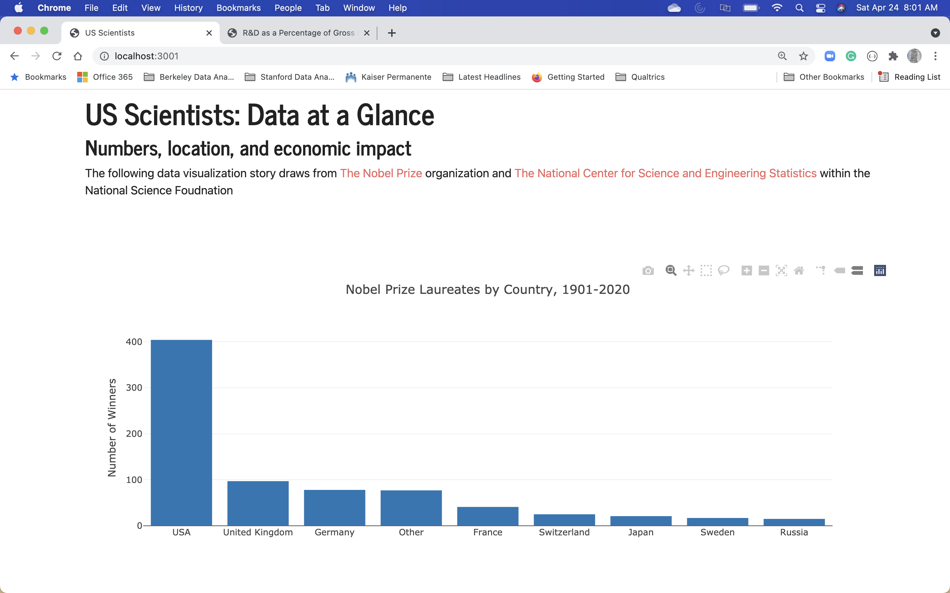

Slide 7
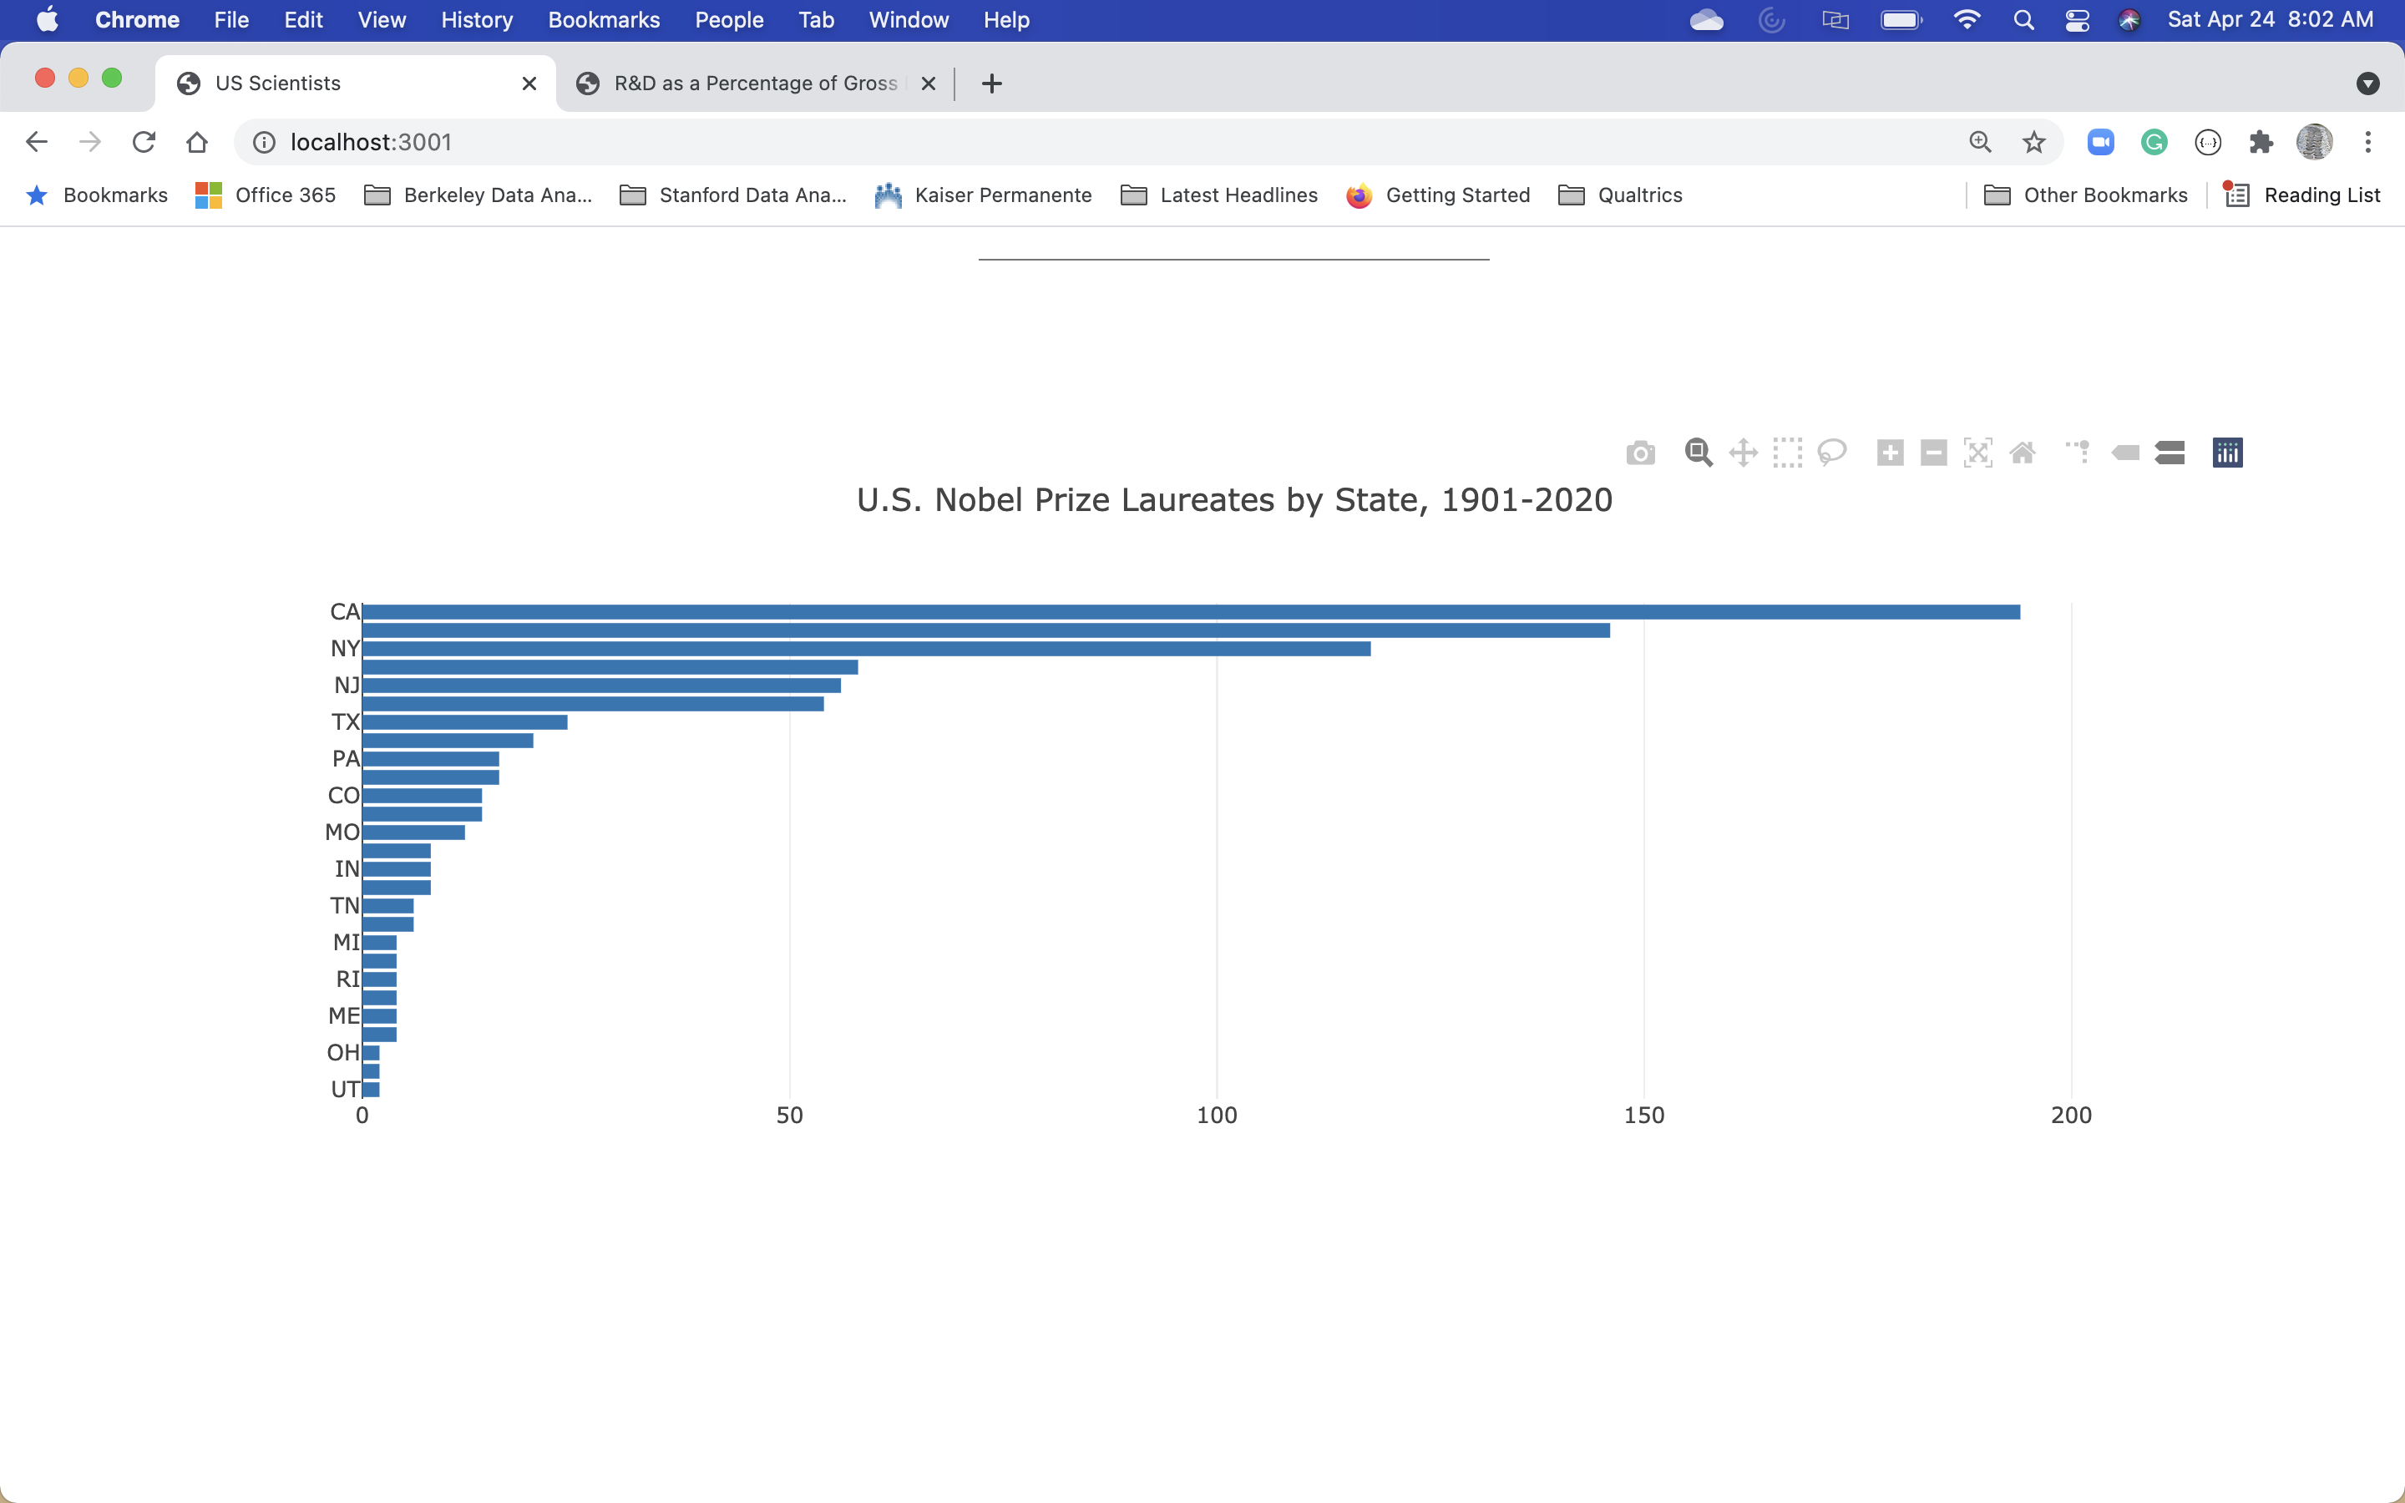

Slide 8
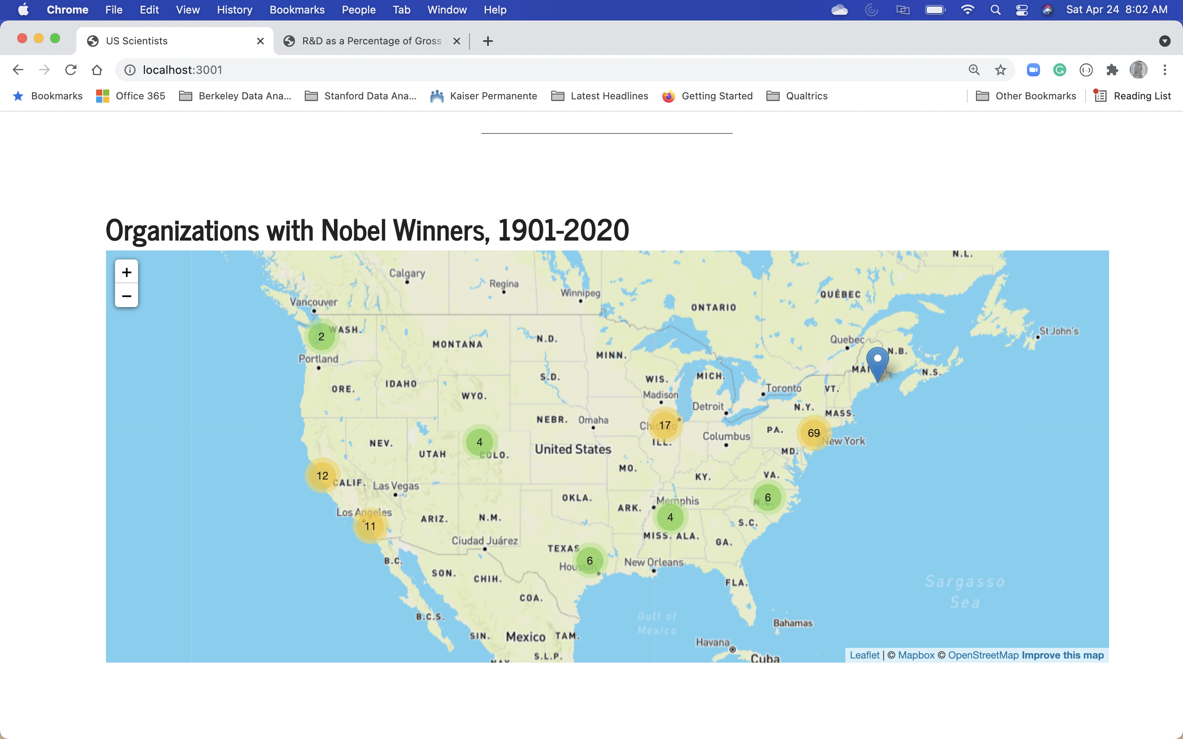

Slide 9
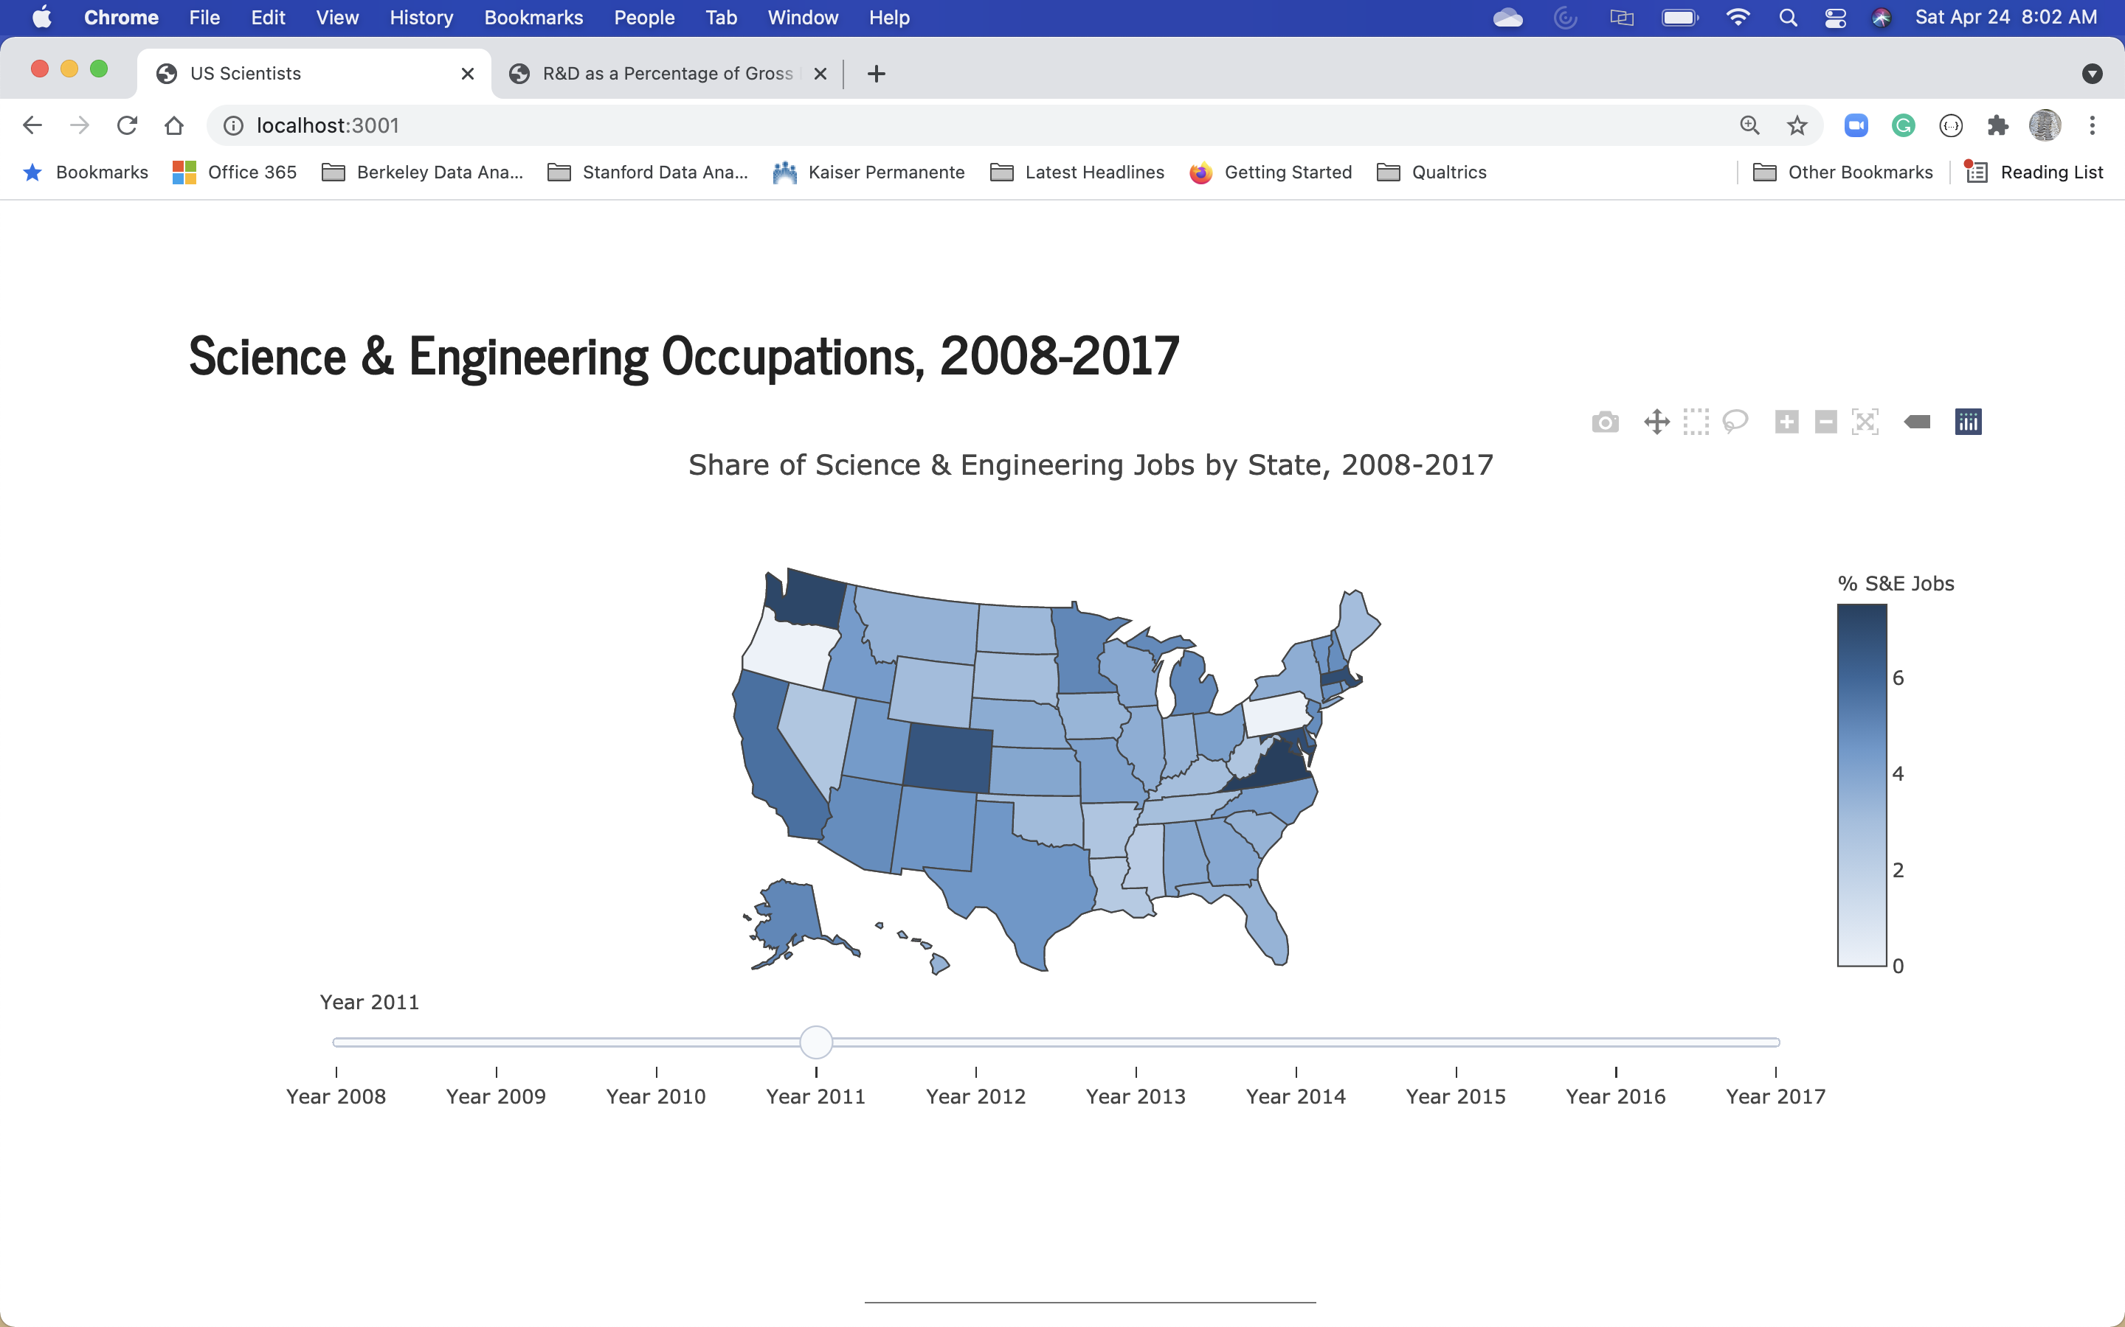

Slide 10
Summary: takeaways
Learned that the U.S. is currently a powerhouse of scientific activities
Majority of Nobel prize laureates
The state of CA has the most (194) followed by MA and NY
The University of California System had the most laureates (42), followed by Harvard and Stanford.
Relatively speaking, S&E jobs and R&D activities are below 10% of all jobs per state
Recommendation: In this technological age, more investment and training are likely to be needed for the U.S. to continue to be innovative in advancing society’s needs.

Slide 11
Lessons learned: If I had More Time
Explore the NCSES data:
Gender and Under-representative Minority gaps in STEM
The Stay-Rate of Foreign Nationals in the US
More advance data visuals
Sankey diagram (country to prize category)
Scrolling D3.js
There are a lot of data viz on Nobel Prize winners
Try to re-engineer some of advanced visuals
Probably require more data scraping and cleaning

Slide 12
